Slide 1
What is an abstract noun?
L/Q: Can I show how to form them?
Can I be imaginative with them?

Slide 2
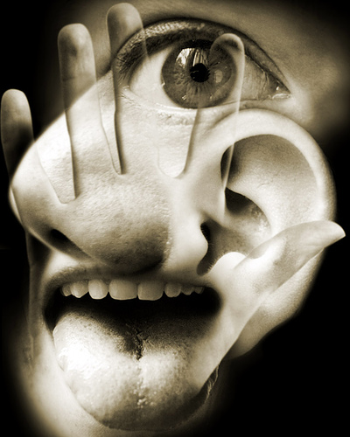
As you know, a noun is the NAME of a thing, a person or a place.
You can TOUCH it, SEE it, SMELL it……..

Slide 3
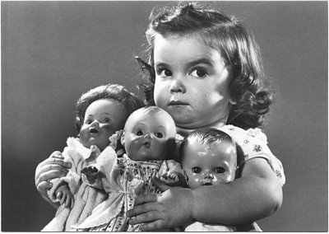
Abstract nouns…..
Are the names for things which we CANNOT see, touch or smell……
Greed

Slide 4
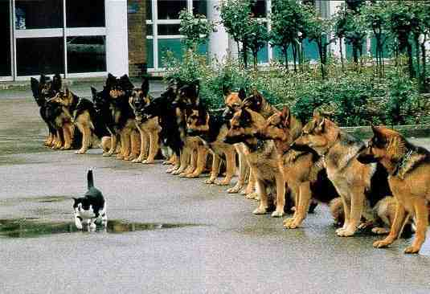
We can make ABSTRACT NOUNS from VERBS ADJECTIVES……
ANGRY = ANGER
COURAGEOUS = ?

Slide 5
Can you make an abstract noun from…?
Proud
Desperate
Beautiful
Hopeful
Miserable
True
Inform
Relax
Educate
Painful
Pride
Despair
Beauty
Hope
Misery
Truth
Information
Relaxation
Education
Pain

Slide 6
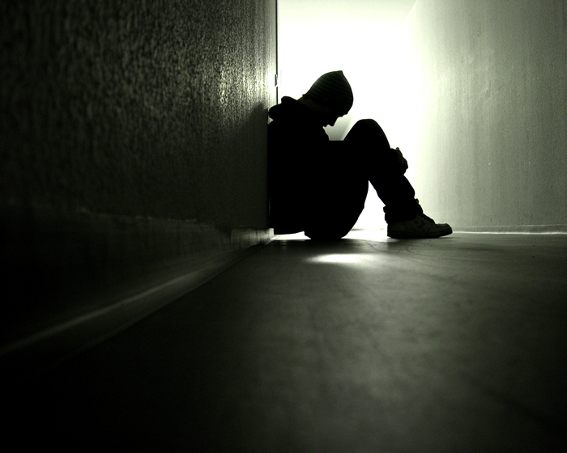
What abstract noun is being shown?
loneliness

Slide 7
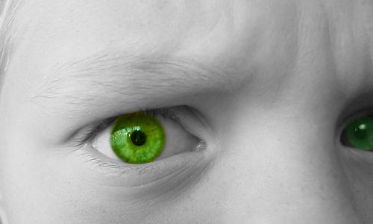
What abstract noun is being shown?
ENVY

Slide 8
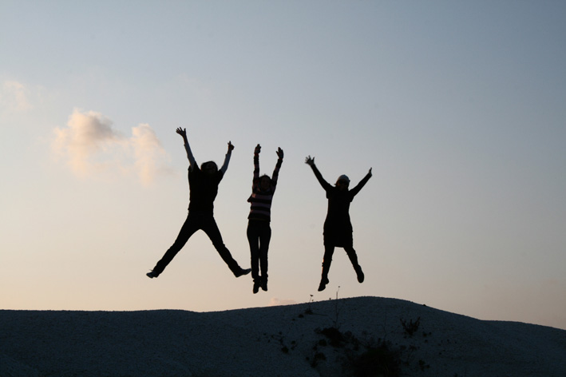
What abstract noun is being shown?
HAPPINESS !

Slide 9
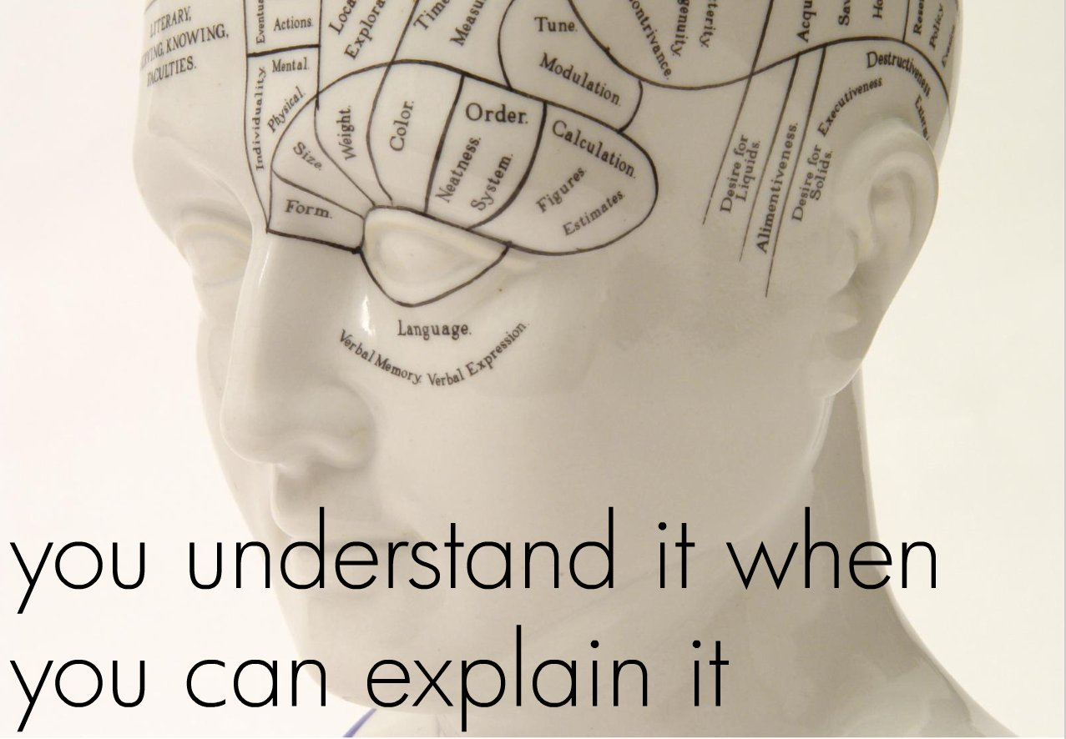
DO WE HAVE THE IDEA NOW?

Slide 10
Abstract nouns are everywhere…
The sword of DESTINY!

Slide 11
THE REALM OF DARKNESS

Slide 12
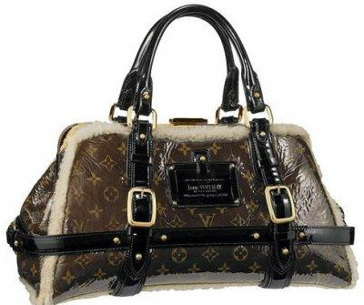
THE HANDBAG OF HAPPINESS..

Slide 13
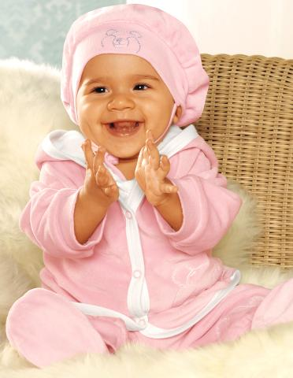
My bundle of fun

Slide 14
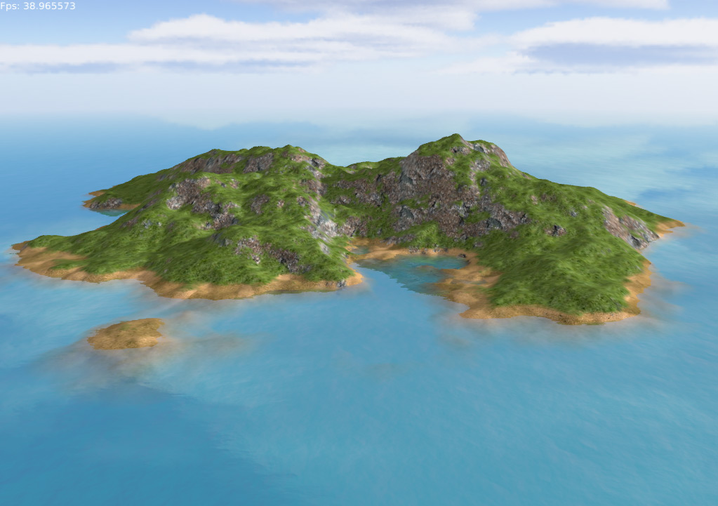
YOUR TURN….
Create a land..it could be an island.
It’s called ABSTRACTIA
It’s got loads of features.
Volcanoes
Forests
Rivers

Slide 15
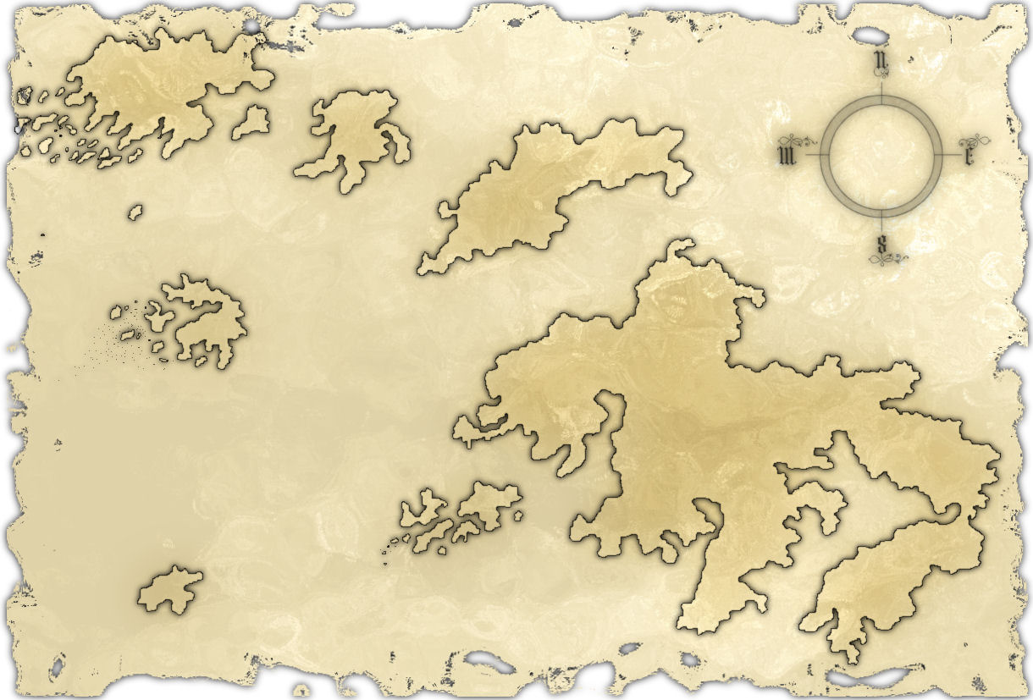
Your task….is to create a number of features.
They must carry the name of an ABSTRACT NOUN.
The Valley of Hope
The Desert of Thirst
Etc.

Slide 16
Since you study Geography…
You’ll need a key
Colour
Other details….
Make this a masterpiece.

Slide 17
Look at your worksheet and get going….!

